Slide 1
Lead SCORING (Case Study)

Slide 2

Exploratory Data Analysis
Conversion rate is close to 37%
Most lead origin from add forms
Most leads come from Olark Chart,Organic Search,Direct Traffic,Google
Some leads also come from Reference and welingak Website though the lead count is low but their conversion rate is High Weave relatable stories into your presentation using narratives that make your message memorable and impactful
Email opened was the last activity performed by the most
Conversion rate is high of sms sent.

Slide 3
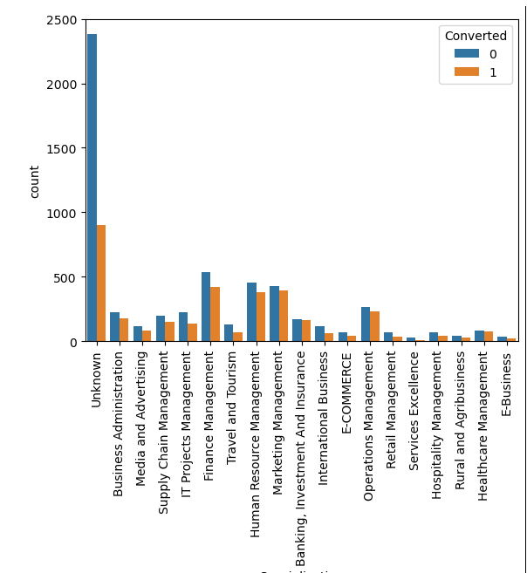
Exploratory Data Analysis-II
We should target people having specialization in Finance Management,HR,Marketing Management,Banking Investment and Insurance,Operation Management and Health care Mangement as the lead conversion rate is only slightly lesser than 50%

Slide 4
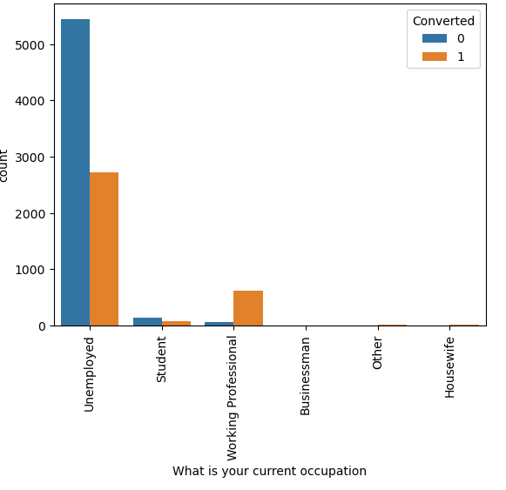
Exploratory Data Analysis-III
Working Professionals have a high conversion rate
Unemployed people are the most in number but they have a low conversion rate

Slide 5
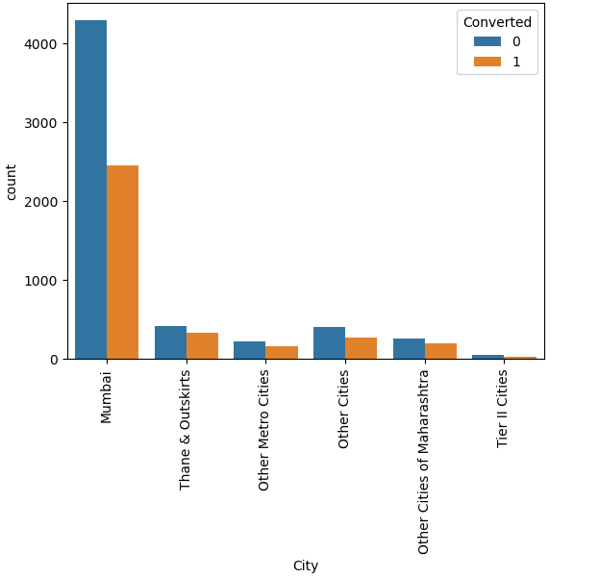
Exploratory Data Analysis-IV
Most leads come from mumbai city

Slide 6
Exploratory Data Analysis-V
Most leads come from mumbai city

Slide 7
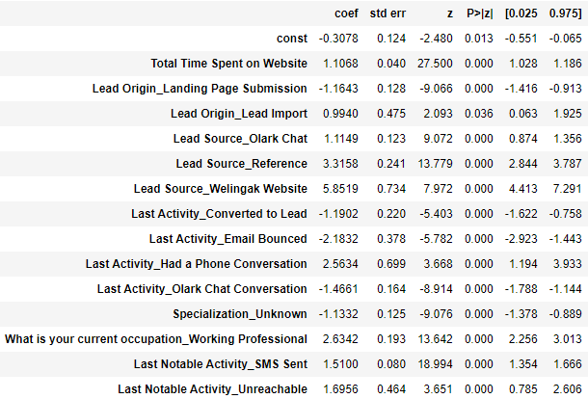
FINAL model Statistics
Lead Source_Welingak Website, Lead Source_Reference, what is your current occupation_Working Professional where the variables which contributed the most of a lead getting converted.

Slide 8
Training data statistics
Overall Accuracy is 81%
Sensitivity is 70%
Specificity is 88%
False positive is around 11%
Positive predicted value is 79%
Negative predicted value is 82%
Precision is 79%
Recall is 70 %

Slide 9
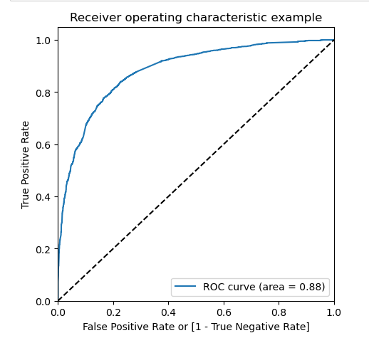
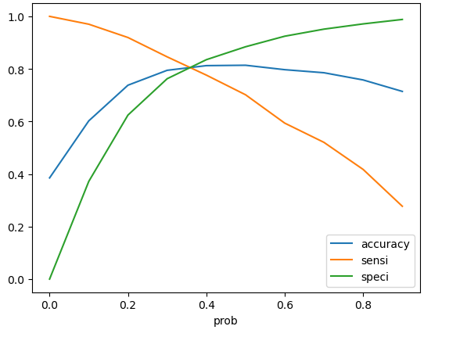
ROC curve
Since our area under curve is close to 88 %. Our model is a good one
Optimal cutoff probability is that prob where we get balanced sensitivity and specificity. In our previous model we took the default cutoff of 0.5 , but we need an optimal cutoff to have the best sensitivity and specificity
Cutoff point calculated from our analysis is 0.37

Slide 10
Test data statistics
Overall Accuracy is 81%
Sensitivity is 79%
Specificity is 81%
False positive is around 18%
Positive predicted value is 70%
Negative predicted value is 87%

Slide 11

Thank you

